Slide 1
Probability & Hypothesis Testing
What you need to know to make sense of statistical testing of any kind, and to understand why we will ditch p-values for the rest of the course!
Introduction to Statistics for Ecology and Evolutionary Biology
Week 5, October 11

Slide 2
Introduction to probability

Slide 3
Definition of probability
The probability of an outcome is the proportion of times the outcome would occur if the random phenomenon could be observed an infinite number of times.
Probabilities always range between 0 and 1

Slide 4
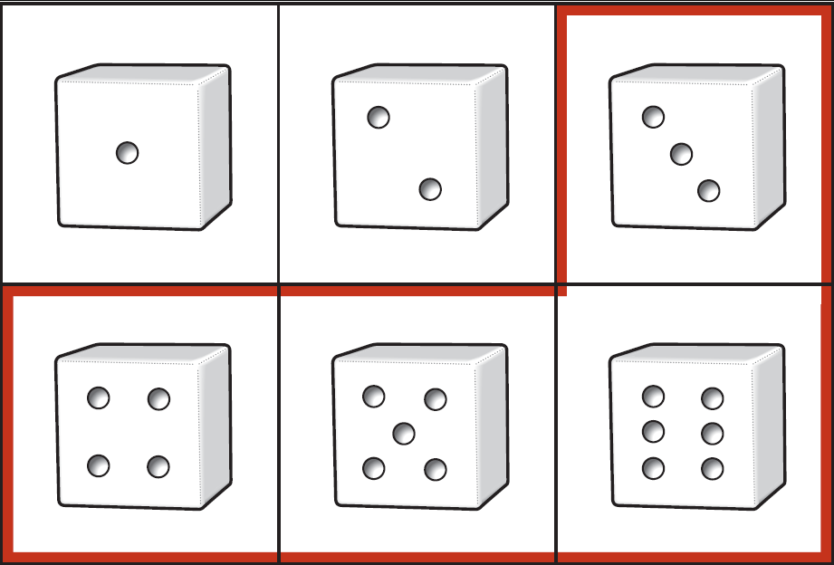
Calculating probability
To calculate probability, we need to define
Sample space: list of all possible outcomes
Event: any potential subset of the sample space
Example: Rolling dice
Sample space: 6 possible outcomes
Event: Result is greater than 2
Notation:
Pr[result > 2] = 4/6
Venn Diagram

Slide 5
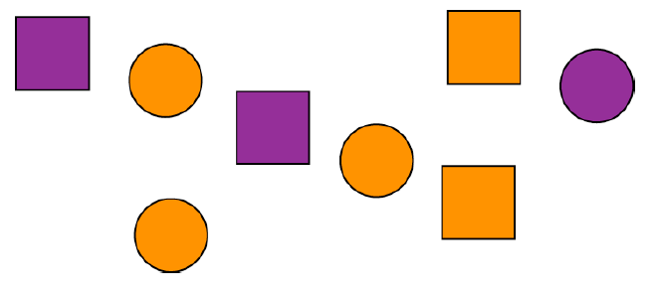
Mutually exclusive events
Two events are mutually exclusive if they cannot both occur simultaneously
Pr[rolling 1 AND rolling 2] = 0
Pr[purple AND square] ≠ 0

Slide 6
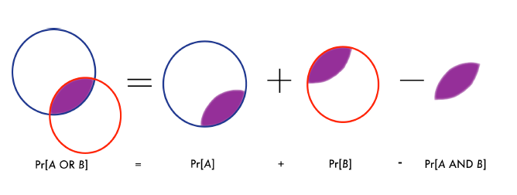
General addition principle
Pr[A or B] = Pr[A] + Pr[B]
Pr(A or B) = Pr(A ∪ B) = Pr(A) + Pr(B)
Pr[not A] = 1 – Pr[A]

Slide 7
Multiplication rule
Two events are independent if the occurrence of one says nothing about whether the second will occur.
If two events A and B are independent, then the chance of both occurring together equals:
Pr[A and B] = Pr[A] x Pr[B]
Pr(A and B) = Pr(A ∩ B) = Pr(A) * Pr(B)

Slide 8
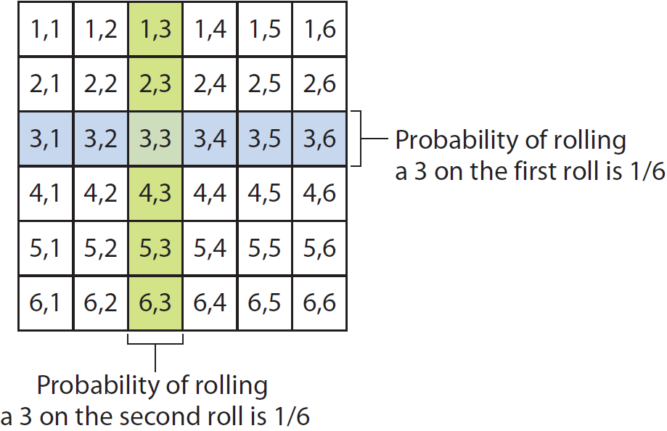
Multiplication rule

Slide 9
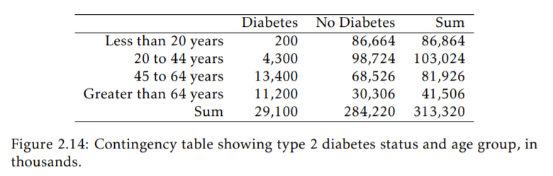
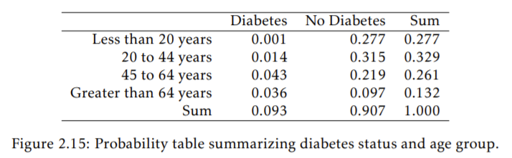
Marginal and joint probabilities
Marginal probabilities: Probability of ONE type of event, here either the chance of being in a particular age group, or the chance of having diabetes.

Slide 10
Marginal and joint probabilities
Joint probabilities: Probability of TWO events happening at the same time, e.g., the chance of being diabetic and <20 years old.

Slide 11
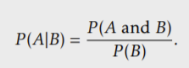
Conditional probability
Both joint and marginal probabilities are calculated relative to the entire population.
However, conditional probability is the probability of two events happening together, relative to another event.
Marginal probability of being >64 years old
Joint probability for diabetes AND >64 years old

Slide 12
Probability distributions

Slide 13
Why do we care?
Probability distributions help us quantify the possible outcomes of a random experiment / study and from that, calculate the probability of each possible outcome based on that distribution. This forms the basis of hypothesis testing.

Slide 14
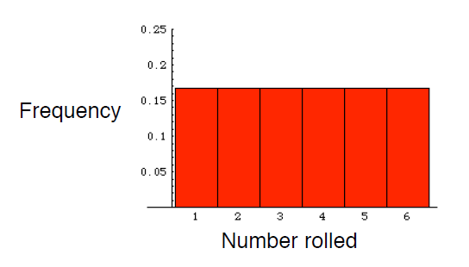
Probability distribution
A probability distribution describes the relative frequency of all mutually exclusive outcomes of a random trial.
Example: The probability distribution for the outcome of a roll of a die

Slide 15
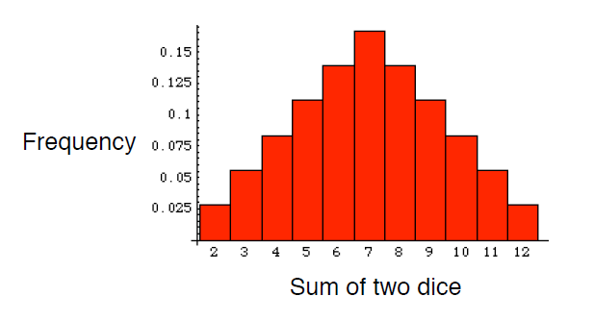
Probability distribution
A probability distribution describes the relative frequency of all mutually exclusive outcomes of a random trial.
Example: The probability distribution for the sum of a roll of two dice

Slide 16
Discrete probability distributions
Possible outcomes are discrete events (e.g., like rolling dice)
Summation of probability over the valid values yields 1
Discrete probability distributions all have an associated probability mass function (pmf)

Slide 17
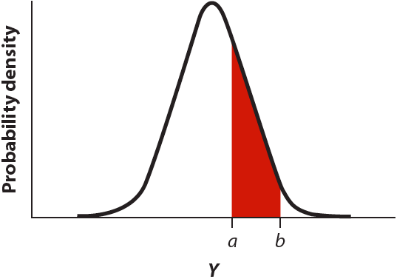
Continuous probability distributions
Probability of any specific Y is infinitesimally small
Probability is better thought of as the area under the curve in some range around Y
Area under the curve always adds to 1
Continuous probability distributions all have an associated probability density function (pdf)

Slide 18
Kinds of probability distributions

Slide 19
Binomial Distribution
A discrete probability distribution with two parameters:
n = number of trials, p = probability of success
Outcome is the number of successes (x) in n trials with probability of success p
p is the parameter we are trying to estimate!
Parameters within a discrete probability distribution can be continuous!
Notes:
Note how the word “parameter” is used here to describe the defining characteristics of a statistical distribution
So parameters define a statistical distribution, and we are interested in estimating these parameters to answer ecological questions

Slide 20
Binomial Distribution: Examples
Infection or disease (yes/no)
Survival (survived/died)
Occurrence (occupied/unoccupied)
http://capitalnaturalist.blogspot.com/2017/10/mangy-foxes.html
Notes:
Data that are commonly expressed as proportions are often modeled as binomial events
http://capitalnaturalist.blogspot.com/2017/10/mangy-foxes.html

Slide 21
Binomial Distribution: Visualized
Notes:
These are the probability mass functions for three different binomial distributions
Show sample code demonstrating dbinom(), plotting, and rbinom()
https://en.wikipedia.org/wiki/Binomial_distribution#/media/File:Binomial_distribution_pmf.svg

Slide 22
Binomial Distribution
The probability mass function in R:
dbinom(x, size, prob)
Where x = the number of successes, size = n, prob = p
The random generation function in R:
rbinom(n, size, prob)
Where n = the number of observations to generate, size = n, prob = p

Slide 23
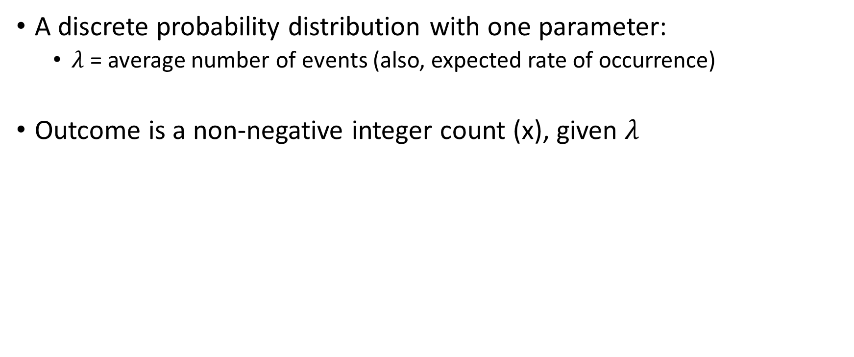

Poisson Distribution
A discrete probability distribution with one parameter:
$λ$ = average number of events (also, expected rate of occurrence)
Outcome is a non-negative integer count (x), given $λ$
$λ$ is the parameter we try to estimate!

Slide 24
Poisson Distribution: Examples
Any sort of organismal count data might be reasonably modeled as Poisson distributed
Notes:
Any sort of organismal count data might be reasonably modeled as Poisson distributed
http://www.vernalpools.me/wp-content/uploads/2015/06/5_VernalPool_6411764_orig.jpg

Slide 25
Poisson Distribution: Visualized
Notes:
These are the probability mass functions for three different Poisson distributions
https://en.wikipedia.org/wiki/Binomial_distribution#/media/File:Binomial_distribution_pmf.svg

Slide 26
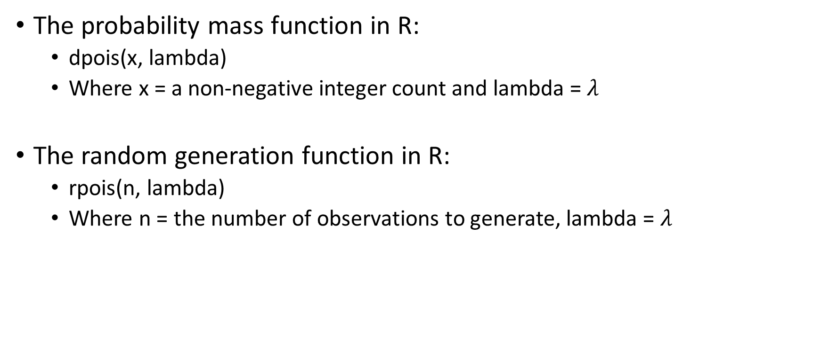
Poisson Distribution
The probability mass function in R:
dpois(x, lambda)
Where x = a non-negative integer count and lambda = $λ$
The random generation function in R:
rpois(n, lambda)
Where n = the number of observations to generate, lambda = $λ$

Slide 27
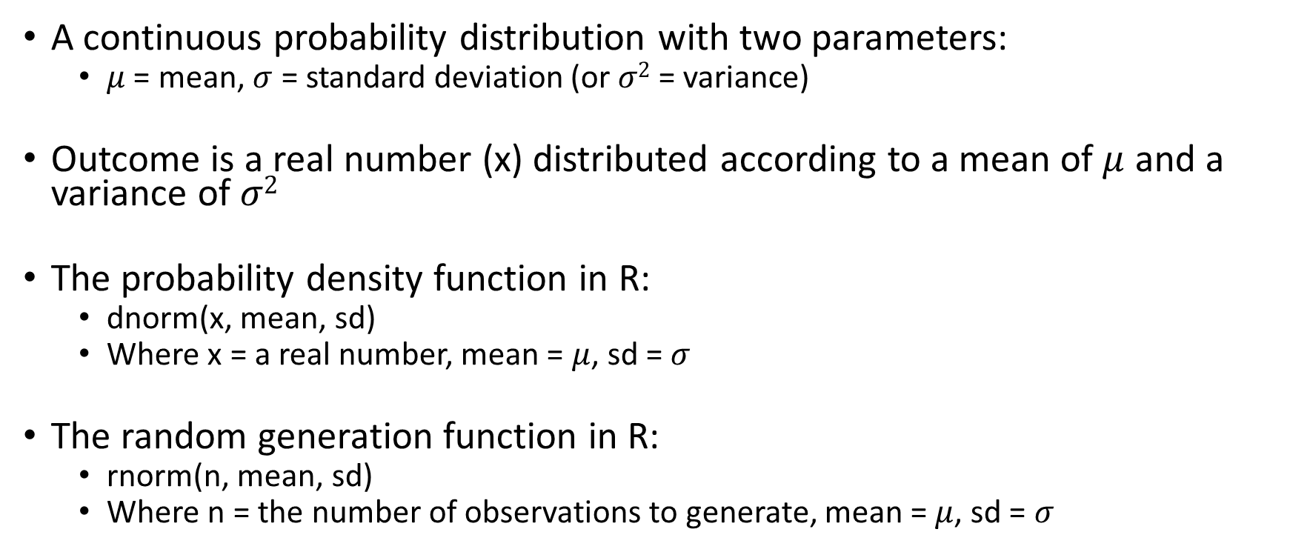
Normal Distribution
A continuous probability distribution with two parameters:
$μ$ = mean, $σ$ = standard deviation (or $σ2$ = variance)
Outcome is a real number (x) distributed according to a mean of $μ$ and a variance of $σ2$
The probability density function in R:
dnorm(x, mean, sd)
Where x = a real number, mean = $μ$, sd = $σ$
The random generation function in R:
rnorm(n, mean, sd)
Where n = the number of observations to generate, mean = $μ$, sd = $σ$
Notes:
Also called the Gaussian distribution
Greek letter “mu” for the mean parameter, “sigma” for the standard deviation parameter

Slide 28
Normal Distribution: Visualized
Notes:
These are the probability density functions for four different normal distributions
https://en.wikipedia.org/wiki/Normal_distribution#/media/File:Normal_Distribution_PDF.svg

Slide 29
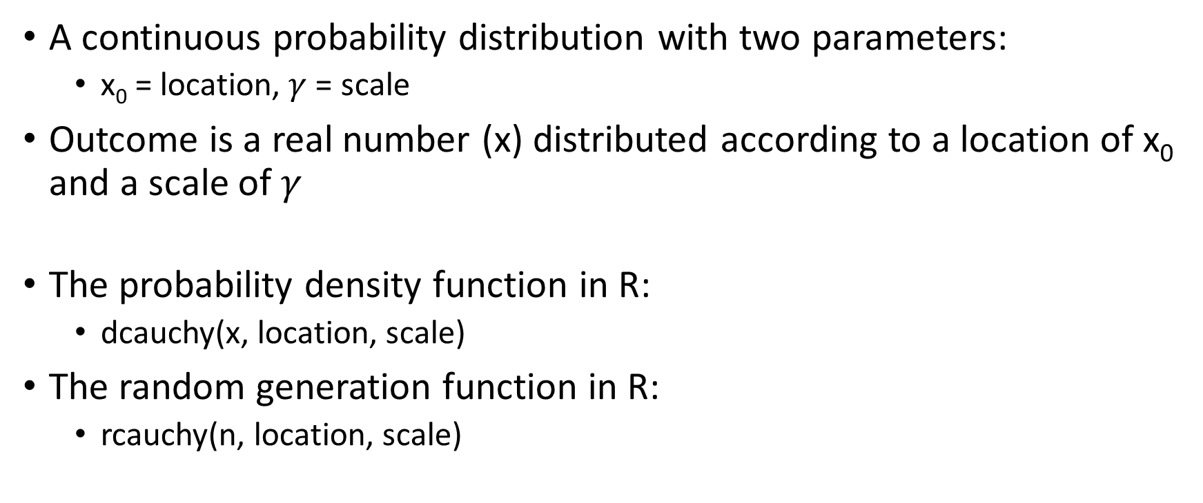
Cauchy Distribution
A continuous probability distribution with two parameters:
x₀ = location, $γ$ = scale
Outcome is a real number (x) distributed according to a location of x₀ and a scale of$γ$
The probability density function in R:
dcauchy(x, location, scale)
The random generation function in R:
rcauchy(n, location, scale)
Notes:
Relative to the normal distribution, the Cauchy distribution has much fatter tails, making values far from the “location” more likely
Greek letter “gamma” for the scale parameter

Slide 30
Cauchy Distribution: Visualized
Notes:
These are the probability density functions for four different Cauchy distributions
https://en.wikipedia.org/wiki/Cauchy_distribution#/media/File:Cauchy_pdf.svg
See sample code comparing pdfs for both the normal and Cauchy distributions

Slide 31
Null Hypothesis Testing

Slide 32
What null hypothesis testing entails…
Hypotheses are about populations but tested with data from samples.
Null hypothesis (H₀): a specific statement about a population parameter made for the purposes of argument.
Alternate hypothesis (H_{A}): represents all other possible parameter values except that stated in the null hypothesis.
Hypothesis testing compares data to the expectations of a specific null hypothesis. If the data are too unusual, assuming that the null hypothesis is true, then the null hypothesis is rejected.

Slide 33
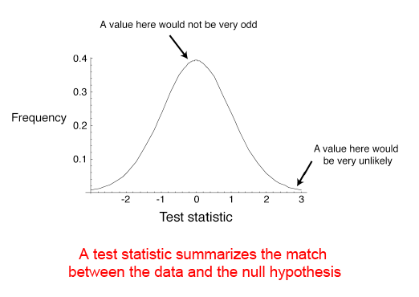
Test statistics follow a known distribution, for example, the normal distribution

Slide 34
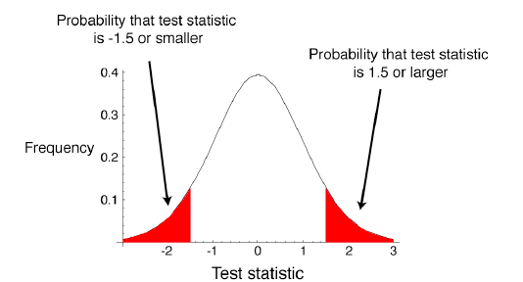
How likely are the observed values if H₀=TRUE?
A p-value is the probability of getting the data, or something as or more unusual, if H₀ were true.

Slide 35
Statistical significance
An arbitrary alpha (significance) level is chosen. For example, p=0.05.
A test statistic is calculated from the sample (e.g., t-statistic, chi-square).
If the likelihood of the value of the test statistic arising under H₀ is smaller than alpha, the null hypothesis is rejected.
H₀
β
1-α
1-β
α/2
α/2
Reject H₀
Accept H₀
Reject H₀
Notes:
Under the null hypothesis, we expect a distribution of data with a specific mean, for example zero.

Slide 36
The problem with null hypothesis significance testing (NHST)
Cohen, 1994 and many others…

Slide 37
What's wrong with NHST?
To cite Cohen:
“Well, among many other things, it does not tell us what we want to know, and we so much want to know what we want to know that, out of desperation, we nevertheless believe that it does!”

Slide 38
So, what does NHST tell us?
P(D|H₀): Given that H₀ is true, what is the probability of these (or more extreme) data?
This logic is equivalent to the following:
If a person is an American, then he is probably not a member of Congress.
This person is a member of Congress.
Therefore, he is probably not an American.

Slide 39
So, what does NHST tell us?
P(D|H₀): Given that H₀ is true, what is the probability of these (or more extreme) data?
This logic is equivalent to the following:
If the null hypothesis is true, then this data is improbable.
This data has occurred.
Therefore, the null hypothesis is probably not true.

Slide 40
What do we really want to know?
P(H₀|D): Given that data, what is the probability of the null hypothesis being true?
We want to reject the null hypothesis if it is unlikely to be true given the data. This probability can only be calculated from P(H₀), the probability of the null hypothesis a priori, using Bayes’ Theorem.

Slide 41
But what if we do not know P(H₀)
Bayesian statistics uses a distribution of prior probabilities for our null hypothesis, called the prior distribution. More about that next week.

Slide 42
The Nil hypothesis
In most cases, the null hypothesis being tested is the complete absence of an effect, difference, or measurement (e.g., the mean difference is 0, the correlation is 0), rather than testing a specific value (e.g., the correlation is 0.2, the mean difference is 20).
This NIL HYPOTHESIS is always FALSE!
A difference/effect always exists, for some decimal place!
"It is foolish to ask 'Are the effects of A and B different?' They are always different—for some decimal place“ (Tukey, 1991)

Slide 43
What’s the point?
“Statistical significance testing can involve a tautological logic in which tired researchers, having collected data on hundreds of subjects, then, conduct a statistical test to evaluate whether there were a lot of subjects, which the researchers already know, because they collected the data and know they are tired. This tautology has created considerable damage as regards the cumulation of knowledge.” (Thompson, 1992).

Slide 44
What to do?
There is no magic bullet!
Exploratory analyses are often more useful than mindless nil hypothesis testing
Focus on effect sizes (does this difference matter?) than p-values
Employ Bayesian statistics and use existing information to inform the probability of our null hypothesis BEFORE testing how likely it is.

Slide 45
Bayes’ theorem
Next week!

